Slide 1
Jermyn Borough Council Meeting
06/19/2025

Slide 2
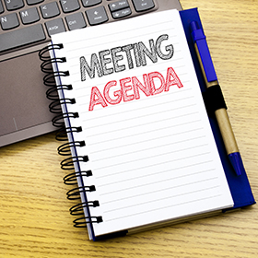
Meeting Agenda
JUNE 19, 2025
CALL TO ORDER
PLEDGE OF ALLEGIANCE
ROLL CALL
PREVIOUS MEETING MINUTES
TREASURE REPORT/BILLS PAYABLE
SECRETARY REPORT
CORRESPONDENCE
PUBLIC COMMENT
PROFESSIONAL REPORTS
COMMITTEE REPORTS
RUSHBROOK CREEK PROJECT UPDATE
CODE ENFORCEMENT
FOLLOW UP ON 400 BLOCK OF MADISON ISSUES
FOLLOW UP ON SHADE TREE CUTTING OF TREES
FOLLOW UP ON GARBAGE CONTRACT
NEW BUSINESS
ADJOURNMENT

Slide 3
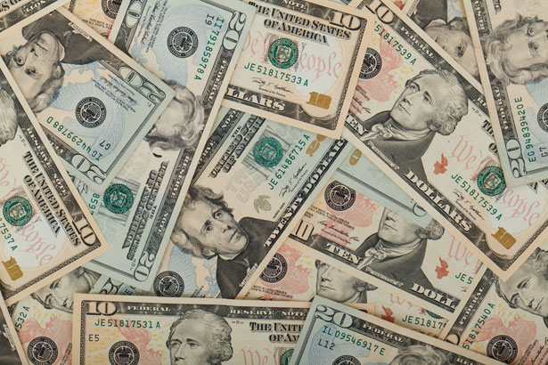
Treasurer’s report
4/17/2025
ASSETS
Checking/Savings
American Rescue Plan Fund 94,589.34
Capital Reserve - DPW 1,083.74
Capital Reserve - Police 6,584.82
Crime Watch Fund 222.69
General Fund - Community 240,784.60
General Fund - FNB 3,727.38
Holiday Lights Fund 400.59
Investment - General Fund 1,141.34

Slide 4
Treasurer’s report
Investment - Liquid Fuels 25,129.76
Investment - Paving Fund 1,153.21
Investment - Recycling 126.03
Investment - Refuse 179.72
Liquid Fuels - FNB 50,799.73
Petty Cash 194.00
Recreations Fund 30,129.57
Recycling - Community 6,993.94
Refuse Checking - FNB 283,689.10
Total Checking/Savings 746,929.56

Slide 5
Treasurer’s report
200000 · Accounts Payable 12,737.32
Long Term Debt 80,180.58

Slide 6
MS4 Minute
https://www.youtube.com/watch?v=sBhzpZD8i8s

Slide 7


